Slide 1

Module 4: Physical Layer
Introduction to Networks v7.0 (ITN)

Slide 2
Module Objectives
Module Title: Physical Layer
Module Objective: Explain how physical layer protocols, services, and network media support
communications across data networks.
Topic Title | Topic Objective
Purpose of the Physical Layer | Describe the purpose and functions of the physical layer in the network.
Physical Layer Characteristics | Describe characteristics of the physical layer.
Copper Cabling | Identify the basic characteristics of copper cabling.
UTP Cabling | Explain how UTP cable is used in Ethernet networks.
Fiber-Optic Cabling | Describe fiber optic cabling and its main advantages over other media.
Wireless Media | Connect devices using wired and wireless media.

Slide 3
4.1 Purpose of the Physical Layer

Slide 4
The Physical Connection
Purpose of the Physical Layer
Before any network communications can occur, a physical connection to a local network must be established.
This connection could be wired or wireless, depending on the setup of the network.
This generally applies whether you are considering a corporate office or a home.
A Network Interface Card (NIC) connects a device to the network.
Some devices may have just one NIC, while others may have multiple NICs (Wired and/or Wireless, for example).
Not all physical connections offer the same level of performance.

Slide 5
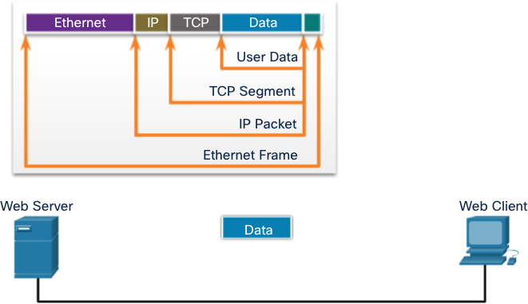
The Physical Layer
Purpose of the Physical Layer
Transports bits across the network media
Accepts a complete frame from the Data Link Layer and encodes it as a series of signals that are transmitted to the local media
This is the last step in the
encapsulation process.
The next device in the path to the destination receives the bits and re-encapsulates the frame, then decides what to do with it.

Slide 6
4.2 Physical Layer Characteristics

Slide 7
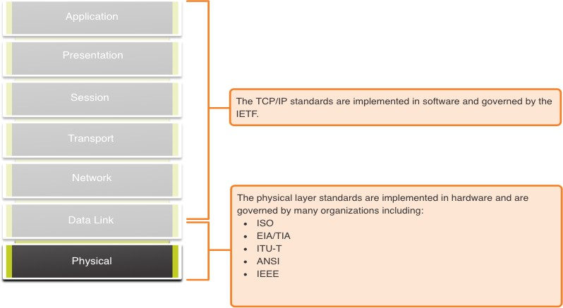
Physical Layer Standards
Physical Layer Characteristics

Slide 8
Physical Components
Physical Layer Characteristics
Physical Layer Standards address three functional areas:
Physical Components
Encoding
Signaling
The Physical Components are the hardware devices, media, and other connectors that transmit the signals that represent the bits.
Hardware components like NICs, interfaces and connectors, cable materials, and cable designs
are all specified in standards associated with the physical layer.

Slide 9
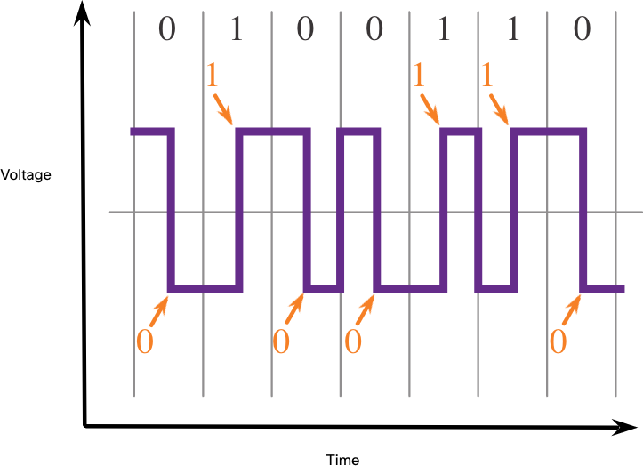
Encoding
Physical Layer Characteristics
Encoding converts the stream of bits into a format recognizable by the next device in the network path.
This ‘coding’ provides predictable patterns that can be recognized by the next device.
Examples of encoding methods include Manchester (shown in the figure), 4B/5B, and 8B/10B.

Slide 10
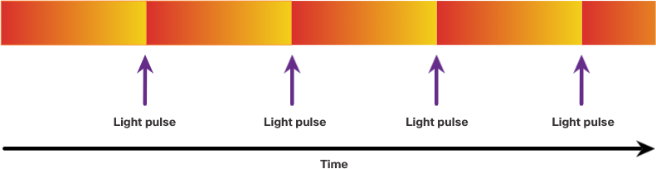
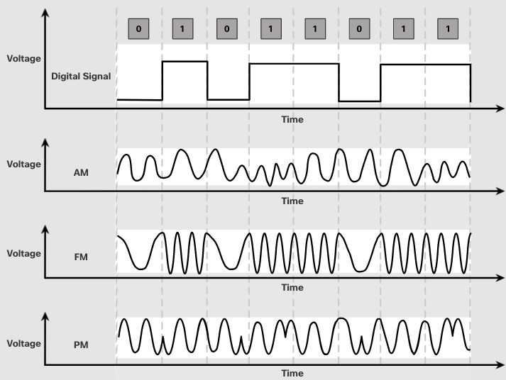
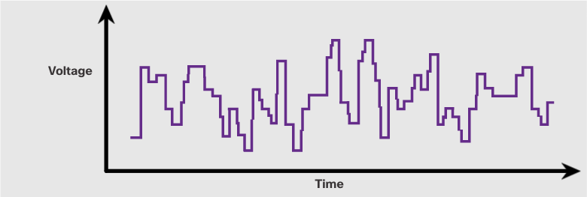
Signaling
Physical Layer Characteristics
The signaling method is how the bit values, “1” and “0” are represented on the physical medium.
The method of signaling will vary based on the type of medium being used.
Light Pulses Over Fiber-Optic Cable
Electrical Signals Over Copper Cable
Microwave Signals Over Wireless

Slide 11
Bandwidth
Physical Layer Characteristics
Bandwidth is the capacity at which a medium can carry data.
Digital bandwidth measures the amount of data that can flow from one place to
another in a given amount of time; how many bits can be transmitted in a second.
Physical media properties, current technologies, and the laws of physics play a role in determining available bandwidth.
Unit of Bandwidth | Abbreviation | Equivalence
Bits per second | bps | 1 bps = fundamental unit of bandwidth
Kilobits per second | Kbps | 1 Kbps = 1,000 bps = 10³ bps
Megabits per second | Mbps | 1 Mbps = 1,000,000 bps = 10⁶ bps
Gigabits per second | Gbps | 1 Gbps – 1,000,000,000 bps = 10⁹ bps
Terabits per second | Tbps | 1 Tbps = 1,000,000,000,000 bps = 10¹² bps

Slide 12
Bandwidth Terminology
Physical Layer Characteristics
Latency
Amount of time, including delays, for data to travel from one given point to another
Throughput
The measure of the transfer of bits across the media over a given period of time
Goodput
The measure of usable data transferred over a given period of time
Goodput = Throughput - traffic overhead

Slide 13
4.3 Copper Cabling

Slide 14
Characteristics of Copper Cabling
Copper Cabling
Copper cabling is the most common type of cabling used in networks today. It is
inexpensive, easy to install, and has low resistance to electrical current flow.
Limitations:
Attenuation – the longer the electrical signals have to travel, the weaker they get.
The electrical signal is susceptible to interference from two sources, which can distort and corrupt the data signals (Electromagnetic Interference (EMI) and Radio Frequency Interference (RFI) and Crosstalk).
Mitigation:
Strict adherence to cable length limits will mitigate attenuation.
Some kinds of copper cable mitigate EMI and RFI by using metallic shielding and grounding.
Some kinds of copper cable mitigate crosstalk by twisting opposing circuit pair wires together.

Slide 15
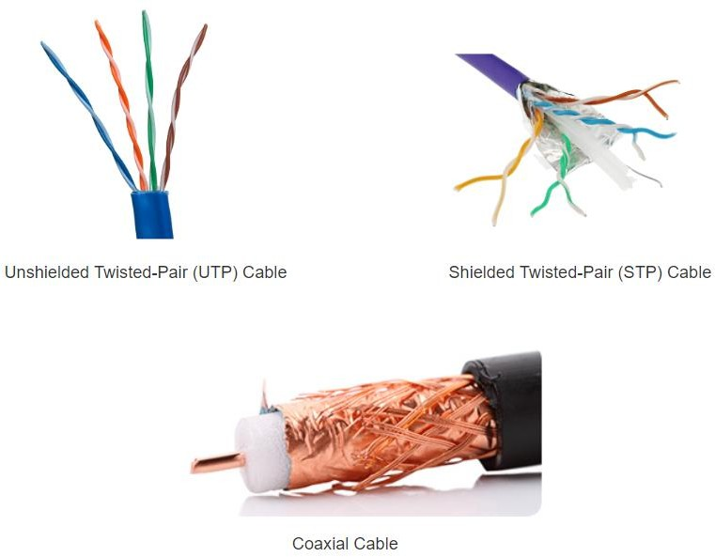
Types of Copper Cabling
Copper Cabling

Slide 16
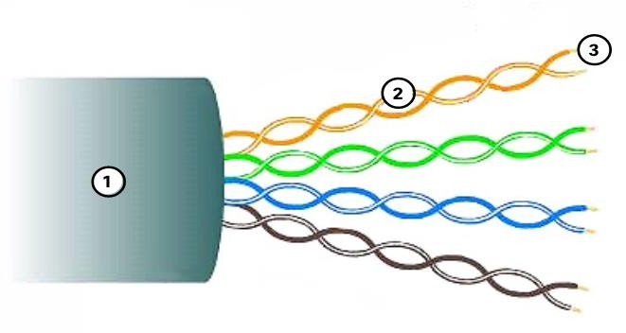
Unshielded Twisted Pair (UTP)
Copper Cabling
UTP is the most common networking media.
Terminated with RJ-45 connectors
Interconnects hosts with intermediary network devices.
Key Characteristics of UTP
The outer jacket protects the copper wires from physical damage.
Twisted pairs protect the signal from
interference.
Color-coded plastic insulation electrically isolates the wires from each other and identifies each pair.

Slide 17
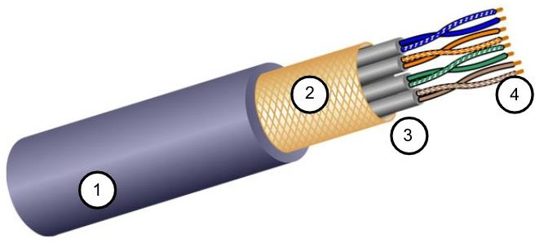
Shielded Twisted Pair (STP)
Copper Cabling
Better noise protection than UTP
More expensive than UTP
Harder to install than UTP
Terminated with RJ-45 connectors
Interconnects hosts with intermediary network devices
Key Characteristics of STP
The outer jacket protects the copper
wires from physical damage
Braided or foil shield provides EMI/RFI protection
Foil shield for each pair of wires
provides EMI/RFI protection
Color-coded plastic insulation electrically isolates the wires from each other and identifies each pair

Slide 18
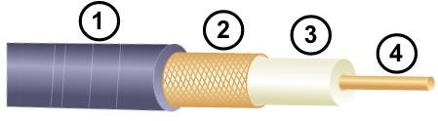
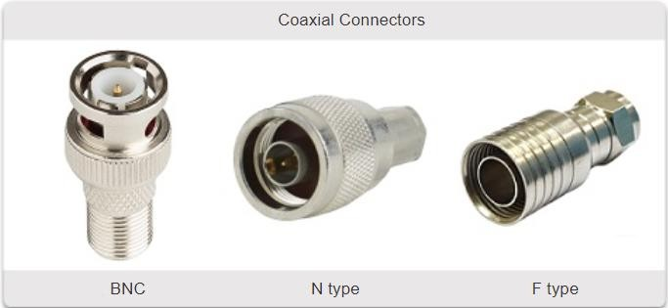
Copper Cabling
Coaxial Cable
Consists of the following:
Outer cable jacket to prevent minor physical
damage
A woven copper braid, or metallic foil, acts as the second wire in the circuit and as a shield for the inner conductor.
A layer of flexible plastic insulation
A copper conductor is used to transmit the
electronic signals.
There are different types of connectors used with coax
cable.
Commonly used in the following situations:
Wireless installations - attach antennas to wireless devices
Cable internet installations - customer premises
wiring

Slide 19
4.4 UTP Cabling

Slide 20
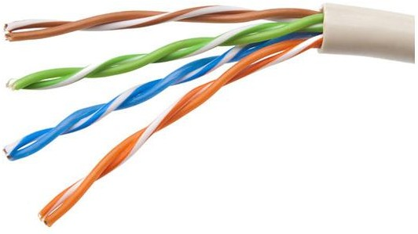
Properties of UTP Cabling
UTP Cabling
UTP has four pairs of color-coded copper wires twisted together and encased in a flexible plastic sheath. No shielding is used. UTP relies on the following properties to limit crosstalk:
Cancellation - Each wire in a pair of wires uses opposite polarity. One wire is negative, the other wire is positive. They are twisted together and the magnetic fields effectively cancel each other and outside EMI/RFI.
Variation in twists per foot in each wire - Each wire is twisted a different amount, which helps prevent crosstalk amongst the wires in the cable.

Slide 21
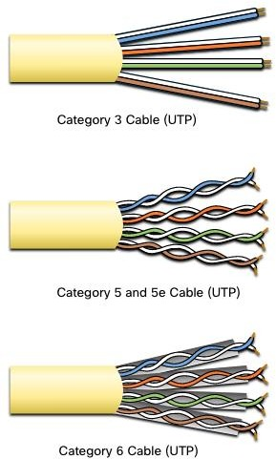
UTP Cabling Standards and Connectors
UTP Cabling
Standards for UTP are established by the TIA/EIA. TIA/EIA- 568 standardizes elements like:
Cable Types
Cable Lengths
Connectors
Cable Termination
Testing Methods
Electrical standards for copper cabling are established by the
IEEE, which rates cable according to its performance.
Examples include:
Category 3
Category 5 and 5e
Category 6

Slide 22

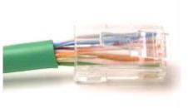
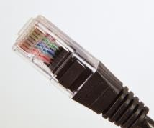
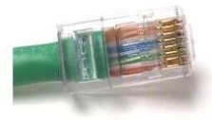
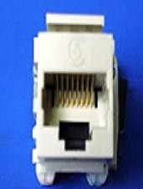
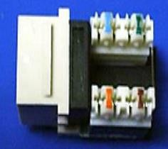
UTP Cabling
UTP Cabling Standards and Connectors (Cont.)
RJ-45 Connector
Poorly terminated UTP cable
Properly terminated UTP cable
RJ-45 Socket

Slide 23
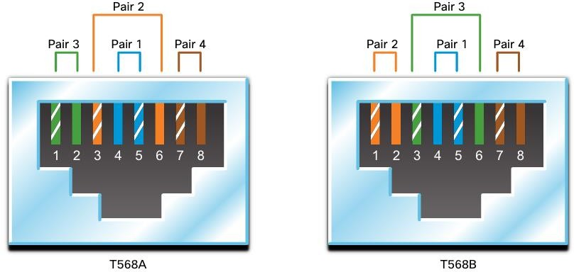
Straight-through and Crossover UTP Cables
UTP Cabling
Cable Type | Standard | Application
Ethernet Straight-through | Both ends T568A or T568B | Host to Network Device
Ethernet Crossover * | One end T568A, other end T568B | Host-to-Host, Switch-to-Switch, Router-to-Router
* Considered Legacy due to most NICs using Auto-MDIX to sense cable type and complete connection
Rollover | Cisco Proprietary | Host serial port to Router or Switch Console Port, using an adapter

Slide 24
4.5 Fiber-Optic Cabling

Slide 25
Properties of Fiber-Optic Cabling
Fiber-Optic Cabling
Not as common as UTP because of the expense involved
Ideal for some networking scenarios
Transmits data over longer distances at higher bandwidth than any other networking media
Less susceptible to attenuation, and completely immune to EMI/RFI
Made of flexible, extremely thin strands of very pure glass
Uses a laser or LED to encode bits as pulses of light
The fiber-optic cable acts as a wave guide to transmit light between the two
ends with minimal signal loss

Slide 26
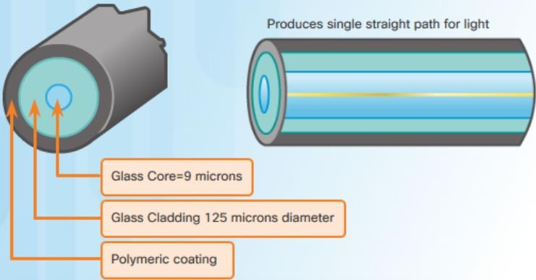
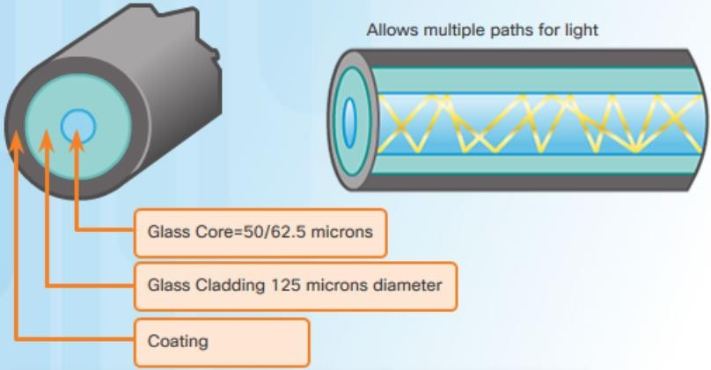
Fiber-Optic Cabling
Types of Fiber Media
Single-Mode Fiber
Multimode Fiber
Very small core
Uses expensive lasers
Long-distance applications
Larger core
Uses less expensive LEDs
LEDs transmit at different angles
Up to 10 Gbps over 550 meters
Dispersion refers to the spreading out of a light pulse over time. Increased dispersion means increased loss of signal strength. MMF has greater dispersion than SMF, with a the maximum cable distance for MMF is 550 meters.

Slide 27
Fiber-Optic Cabling Usage
Fiber-Optic Cabling
Fiber-optic cabling is now being used in four types of industry:
Enterprise Networks - Used for backbone cabling applications and interconnecting
infrastructure devices
Fiber-to-the-Home (FTTH) - Used to provide always-on broadband services to homes and small businesses
Long-Haul Networks - Used by service providers to connect countries and cities
Submarine Cable Networks - Used to provide reliable high-speed, high-capacity solutions capable of surviving in harsh undersea environments at up to transoceanic distances.
Our focus in this course is the use of fiber within the enterprise.

Slide 28
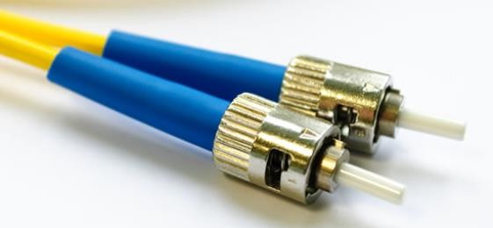
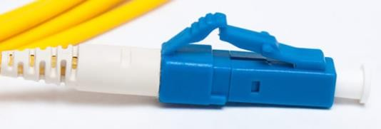
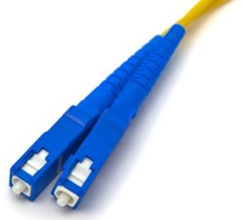
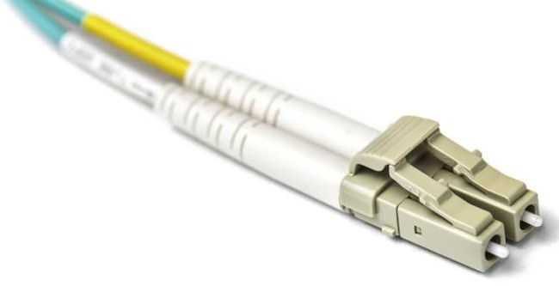
Fiber-Optic Cabling
Fiber-Optic Connectors
Straight-Tip (ST) Connectors
Lucent Connector (LC) Simplex Connectors
Subscriber Connector (SC) Connectors
Duplex Multimode LC Connectors

Slide 29
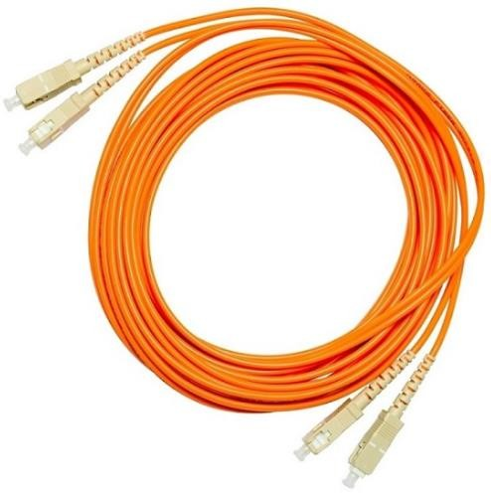
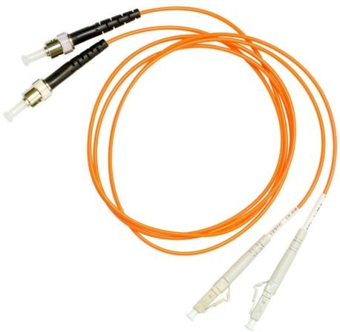
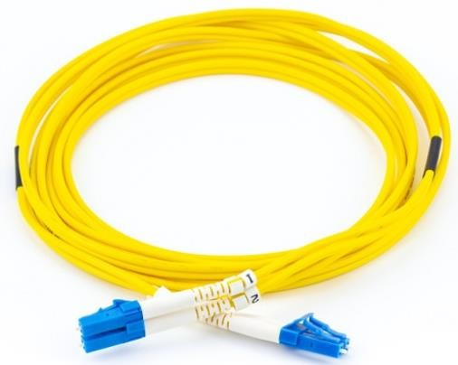
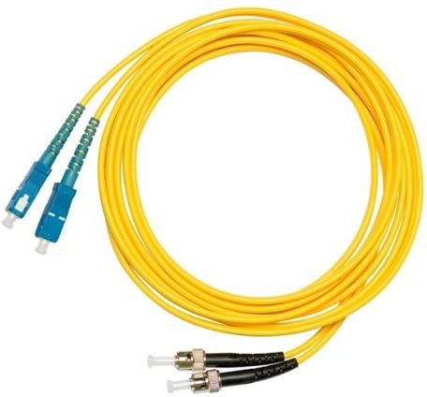
Fiber Patch Cords
Fiber-Optic Cabling
SC-SC MM Patch Cord
LC-LC SM Patch Cord
ST-LC MM Patch Cord
ST-SC SM Patch Cord
A yellow jacket is for single-mode fiber cables and orange (or aqua) for multimode fiber
cables.

Slide 30
Fiber versus Copper
Fiber-Optic Cabling
Optical fiber is primarily used as backbone cabling for high-traffic, point-to-point connections between data distribution facilities and for the interconnection of buildings in multi-building campuses.
Implementation Issues | UTP Cabling | Fiber-Optic Cabling
Bandwidth supported | 10 Mb/s - 10 Gb/s | 10 Mb/s - 100 Gb/s
Distance | Relatively short (1 - 100 meters) | Relatively long ( 1 - 100,000 meters)
Immunity to EMI and RFI | Low | High (Completely immune)
Immunity to electrical hazards | Low | High (Completely immune)
Media and connector costs | Lowest | Highest
Installation skills required | Lowest | Highest
Safety precautions | Lowest | Highest

Slide 31
4.6 Wireless Media

Slide 32
Properties of Wireless Media
Wireless Media
It carries electromagnetic signals representing binary digits using radio or microwave frequencies. This provides the greatest mobility option. Wireless connection numbers continue to increase.
Some of the limitations of wireless:
Coverage area - Effective coverage can be significantly impacted by the physical characteristics of the deployment location.
Interference - Wireless is susceptible to interference and can be disrupted by many common devices.
Security - Wireless communication coverage requires no access to a physical strand of media, so anyone can gain access to the transmission.
Shared medium - WLANs operate in half-duplex, which means only one device can send or receive at a time. Many users accessing the WLAN simultaneously results in reduced bandwidth for each user.

Slide 33
Wireless Media
Types of Wireless Media
The IEEE and telecommunications industry standards for wireless data communications cover both the data link and physical layers. In each of these standards, physical layer specifications dictate:
Data to radio signal encoding methods
Frequency and power of transmission
Signal reception and decoding requirements
Antenna design and construction
Wireless Standards:
Wi-Fi (IEEE 802.11) - Wireless LAN (WLAN) technology
Bluetooth (IEEE 802.15) - Wireless Personal Area network (WPAN) standard
WiMAX (IEEE 802.16) - Uses a point-to-multipoint topology to provide broadband wireless
access
Zigbee (IEEE 802.15.4) - Low data-rate, low power-consumption communications, primarily for Internet of Things (IoT) applications

Slide 34
Wireless LAN
Wireless Media
In general, a Wireless LAN (WLAN) requires the following devices:
Wireless Access Point (AP) - Concentrate wireless signals from users and connect to the existing copper-based network infrastructure
Wireless NIC Adapters - Provide wireless communications capability to
network hosts
There are a number of WLAN standards. When purchasing WLAN equipment,
ensure compatibility, and interoperability.
Network Administrators must develop and apply stringent security policies and
processes to protect WLANs from unauthorized access and damage.

Slide 35
Packet Tracer – Connect a Wired and Wireless LAN
Wireless Media
In this Packet Tracer, you will do the following:
Connect to the Cloud
Connect a Router
Connect Remaining Devices
Verify Connections
Examine the Physical Topology

Slide 36
Lab – View Wired and Wireless NIC Information
Wireless Media
In this lab, you will complete the following objectives:
Identify and Work with PC NICs
Identify and Use the System Tray Network Icons

Slide 37
4.7 Module Practice and Quiz

Slide 38
What did I learn in this module?
Module Practice and Quiz
Before any network communications can occur, a physical connection to a local network, either wired or wireless, must be established.
The physical layer consists of electronic circuitry, media, and connectors developed by engineers.
The physical layer standards address three functional areas: physical components,
encoding, and signaling.
Three types of copper cabling are: UTP, STP, and coaxial cable (coax).
UTP cabling conforms to the standards established jointly by the TIA/EIA. The electrical characteristics of copper cabling are defined by the Institute of Electrical and Electronics Engineers (IEEE).
The main cable types that are obtained by using specific wiring conventions are Ethernet Straight-through and Ethernet Crossover.

Slide 39
What did I learn in this module (Cont.)?
Module Practice and Quiz
Optical fiber cable transmits data over longer distances and at higher bandwidths than any other networking media.
There are four types of fiber-optic connectors: ST, SC, LC, and duplex multimode LC.
Fiber-optic patch cords include SC-SC multimode, LC-LC single-mode, ST-LC multimode, and SC-ST single-mode.
Wireless media carry electromagnetic signals that represent the binary digits of data communications using radio or microwave frequencies. Wireless does have some limitations, including coverage area, interference, security, and the problems that occur with any shared medium.
Wireless standards include the following: Wi-Fi (IEEE 802.11), Bluetooth (IEEE 802.15),
WiMAX (IEEE 802.16), and Zigbee (IEEE 802.15.4).
Wireless LAN (WLAN) requires a wireless AP and wireless NIC adapters.

Slide 40
4.8 Summary

Slide 41
Packet Tracer – Connect the Physical Layer
Module Practice and Quiz
In this Packet Tracer, you will do the following:
Identify Physical Characteristics of Internetworking Devices
Select Correct Modules for Connectivity
Connect Devices
Check Connectivity

Slide 42


